Slide 1
Invitation to join sustainable Colombian CPO with agreed export to biodiesel producer in Nordic countries
By Henrik Wiig, CEO, C2Biotrade
Ole Martin Siem, Chairman, Prestige Group
Oslo, 4. january 2018

Slide 2
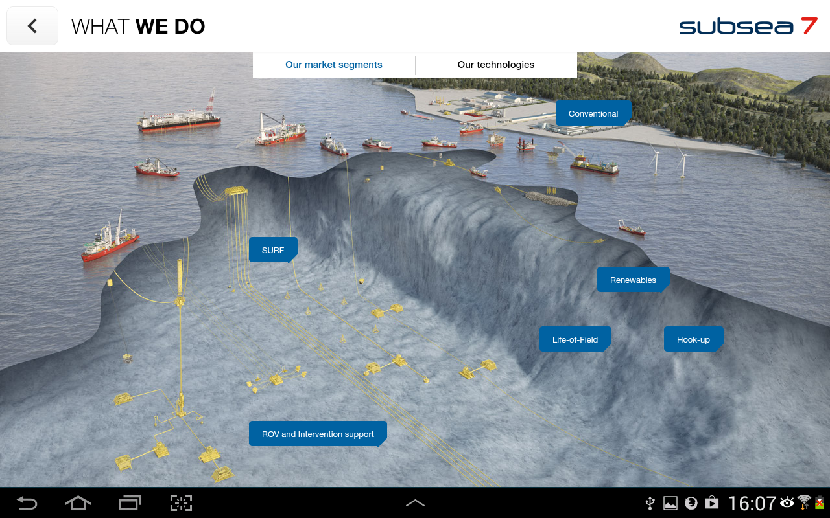
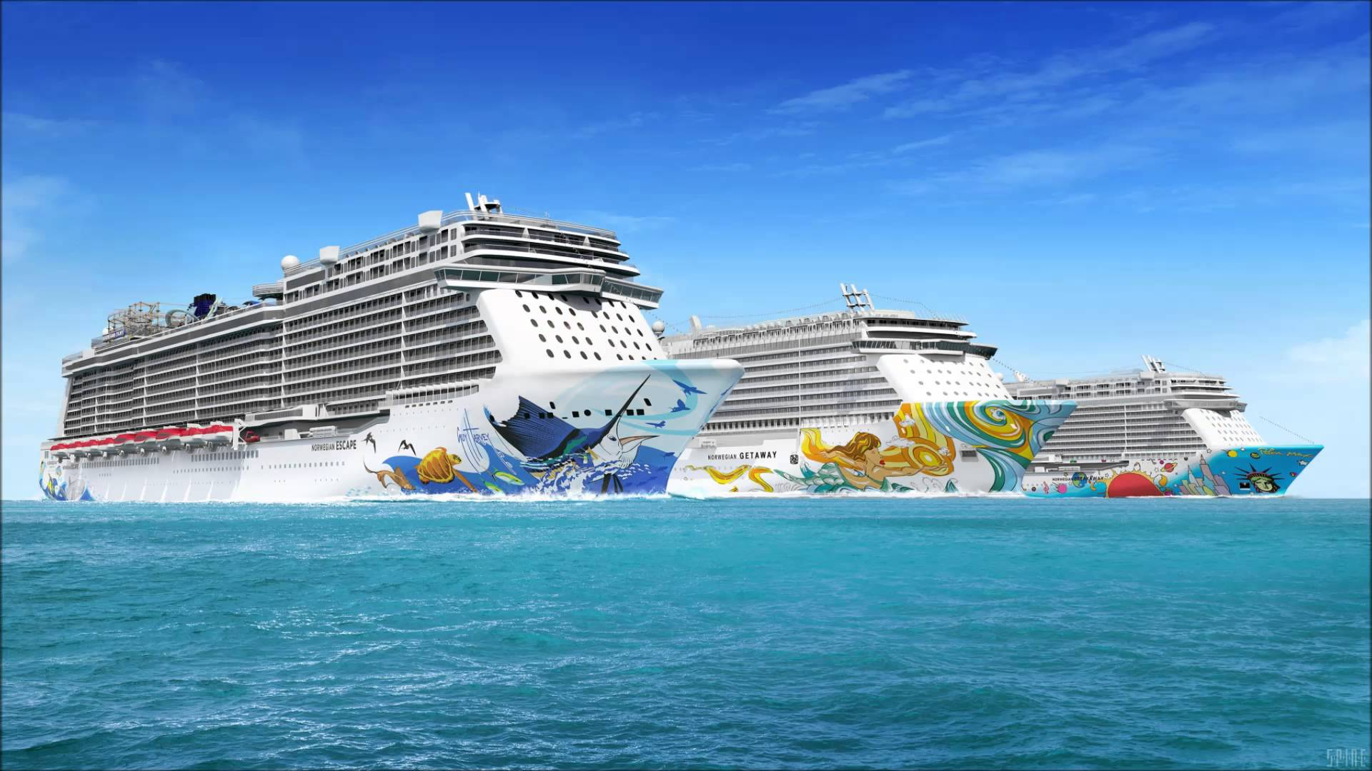
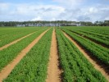
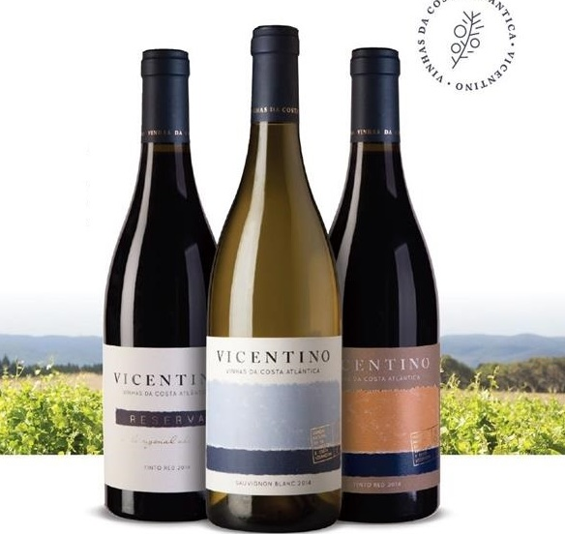
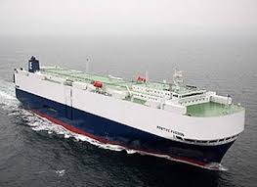
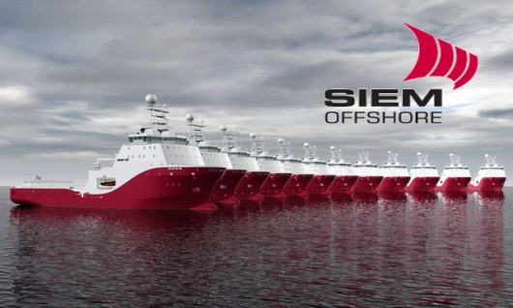
Norwegian Cruise Line turnaround
Petrolium services in
deep seas
Siem Shipping
Cars/bananas
Frupor–Portugal agro/wine

Slide 3
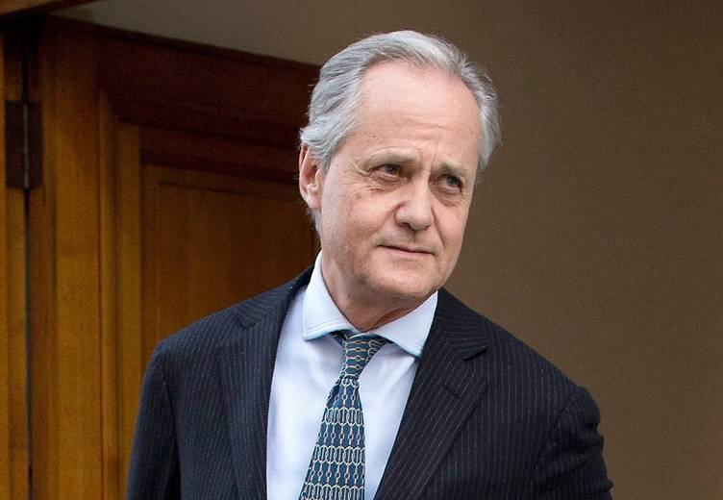
Siem – experienced industralists and investors
Ole Martin Siem, Ole Martin Siem is the Managing Director of Frupor S.A., since the start of the company in 1987. His experience includes finance and management of companies within food production and trading, both in Europe, Africa and South America. Mr. Siem holds a Bachelor of Science Degree (Honours) in Agricultural Economics from Newcastle upon Tyne University, England, as well as from Vestfold Landbruksskole, Norway, as a qualified agronomist. Mr. Siem serves on the Board of several companies, related directly or indirectly to the flower, fruit and vegetable trade such as Chairman of Prestige Group S.A.S. (Colombia), and Star Reefer Inc. (Cayman Islands). Mr. Siem manages his own farm in Norway organically.
Kristian Siem, Kristian Siem is Chairman and Chief Executive Officer of Siem Industries Inc., an industrial holding company, which includes offshore and onshore oil and gas drilling, and subsea construction services, worldwide. Mr. Siem is the Chairman of Subsea7 and Siem Capital AB, Director of Siem Offshore, Star Reefer Inc. and North Atlantic Smaller companies Trust Plc. A native of Norway, Mr. Siem holds a degree in Business Administration from Oslo Institute of Business Administration. He is married, with four children, and resides in Switzerland.

Slide 4
Siem Industries group
History
Started by father Martin Siem, CEO for legendary shipping magnate Fred. Olsen
Invited to save Norwegian Cruise Line in 1997, successful turnaround with profits
Controlled by Siem family trust of five brothers
Ole Martin and Kristian are now the active managers of the businesses
Companies
Subsea7, deep sea oil service; revenue $3600 million
Siem Offshore, oil service vessels; revenue $469 million
Siem Shipping; banana transport; revenue $180 million
Siem Car Carriers; sea transport vehicles, revenue $65 million
Deusa int, potash; EBITDA €8 million
Venn, financial advisory;
BSR Group Holding, solar energy
Flensburger Schiffbau-Gesellschaft

Slide 5
Agrobusiness – Innovative early movers
Frupor SA, Portugal
Acquired 3000 HA cheap land after cooperative failure in 1987
Sunshine, irrigation water and opening EU markets
Land prices increase 130 times in 30 years
Large exporter of China leafs, decorage foliage, carrots and now wine
Ole Martin and Kristian shared ownership
Prestige, Colombia
Aquired 13000 HA cheap land in Los Llanos in 2004
Sunshine, rainfalls, river transport, closeness equator is ideal for palm
Opening world biodiesel market
Expect similar land price increase as in Portugal.
Ole Martin and Kristian shared ownership
Others, Ole Martin
Retail agriculture products, Norway
Private ecological cattle farm, Norway
Greenhouses, Spain

Slide 6
Siem early mover in Los Llanos…
Looked at agriculture in Latin America as part of Norwegian Cruise line turn around operation upto year 2000.
Harbour access (NCL) for agriculture support (FRUPOR) initiative with Cuban authorities failed, but started to look at LA agriculture potential
Norwegian entrepreneur with El Cimarron project in Vichada invited Siem to join in 2001
Siem saw economic potential of inexpensive land, water access, sun/heat and possible future marketing through Rio Orinoco as similar to their experience with Frupor in Portugal
When entrepreneur failed 2004, Siem restructured into Prestige Colombia
Voluntary renegotion with claimants
Re-buying land from colombian tax autorities.

Slide 7
…building palm/biodiesel operation in Vichada
9000 HA titled land and 4000 HA with possession rights
Maize/cattle initially, then planting palm in 2013
650 HA pilot harvest extraction mill with 2000HA/year capacity 2017
16 million usd total own investments, no company debt
Extraction mill 5 million USD
Plantation 6 million USD
Land, roads, houses, infrastructure, 5 million USD
BanColombia supply working capital
Sales income from harvest induce surplus on current account

Slide 8
Invite partners to Prestige Colombia SAS
1400 ha, economy-of-scale using existing extraction mill capacity
7000 ha, economy-of-scale on infrastructure for all titled land
Total land is 9000 ha with titled and 4000 ha possession rights
Shares and influence according to investment
Upto 1 million USD for give 1:1 for contribution in USD as «early-bird sweetner»
No «sweat» money for owners, never paid dividends/salaries
No inflation adjustment since 2004
Land bought at 27 USD/HA in 2004, today estimated value 550 USD/HA, will increase more as investment increases
No value for organization achievements
Above 1 million USD to be discussed
In calculating RoR process, include externality of increasing land prices on all land available through demonstrating that profitable farming is possible in Vichada
Existing management team well experienced in Colombian palm oil
Long term supply agreement to ST1 with price markup for GHG capture

Slide 9
Invite collaborators to supply ST1 demand
Letter of intent St1 – C2Biotrade for supply of 250.000 MT/year CPO for sustainable
Shared ownership ResGrow and Prestige Group; ResGrow owned by Henrik Wiig (PhD), academic turned businessman with experience since in Colombia since 1981.
Sign purchase agreements with producers in Colombia, e.g. Prestige
Invite existing land owners or provide/sell land to new entrants
Optimal to distribute on different geographical areas to spread risk
Provide large scale financing from multilateral/fond/banks
“Blue-copy” and economy of scale in expert/consultant setup to facilitate establishment
Provide government support for ex-ante agreed large scale initiative
Permissions without red-tape and corruption
International development assistance, active state planning and infrastructure

