Slide 1
Sustainable biodiesel- carbón sequestration – rural development – peace
.
ST1 – C2Biotrade signed letter of intent
250.000 t/year Colombian palm oil for sustainable biodiesel
  Henrik Wiig, CEO in C2Biotrade SCI
  4. January 2018,
Reports and presentations in full text in www.resgrow.com

Slide 2
Climate crisis
How the Antillanura palm reduces greenhouse gas emissions
Buyer ST1 and characteristics of the required product
State institutional support necessary
Future stages

Slide 3
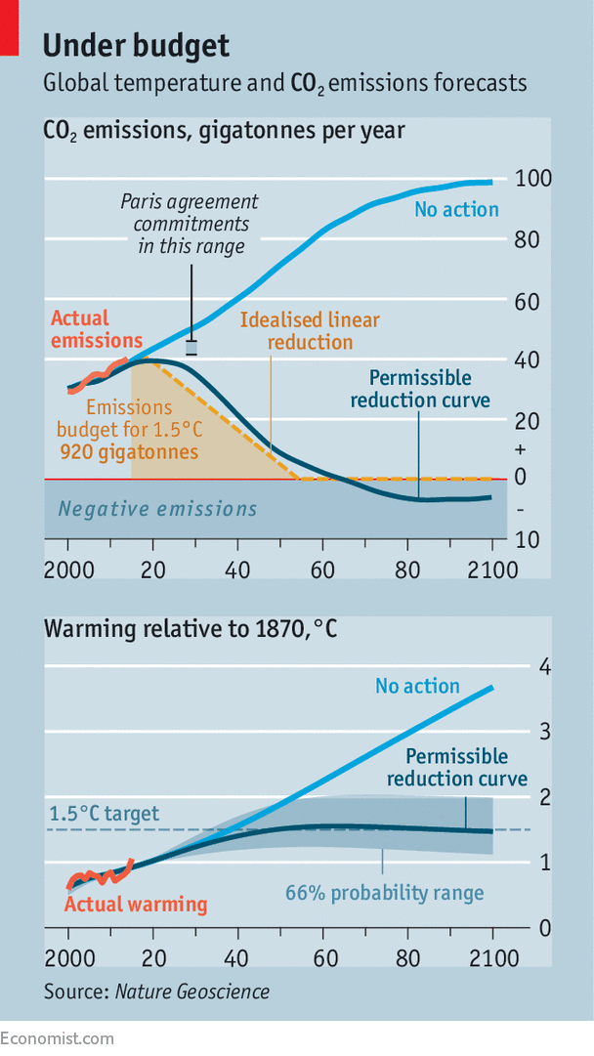
Climate crisis: CO₂ capture is nescesary
Paris agreement 2015
  «Less than 2°C, ideal maximum 1.5°C»
EU Renewable Energy Directive
  10% sustainable in transport 2020
  Norway will blend 20% biofuel in transport 2020
There is not enough products…
  Rapeseed, garbage, cooking oils

Slide 4
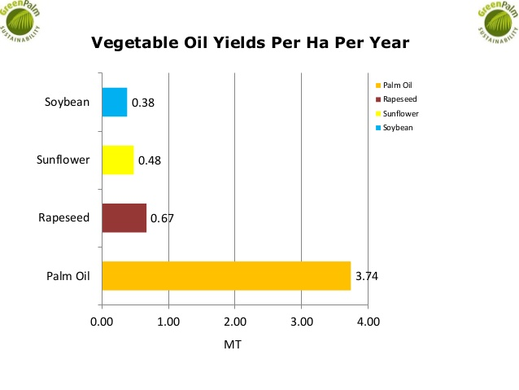
The palm is the solution!
More productive and biodiesel compatible
  Use existing infrastructure until 2030
  Boats, heavy transport and aviation until 2050
Bad reputation of palm not relevant
  95% of deforestation in Asia
  EU parliament prefers solutions that do not compete with food
Stability changes Colombian reputation
  Sector without state control
  Conflicts, displaced people and armed groups
No sales without changing the image!

Slide 5

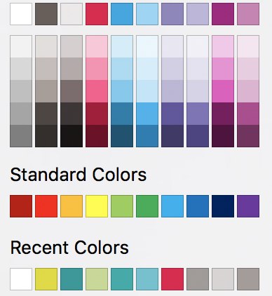


Huella de Carbono en El Cimarron, Vichada
Context
Prestige Colombia SAS is a Colombian palm oil producer in Vichada | Colombia
Oil palm cultivation: Currently 650 ha | Expansion plan to 60.000 ha
Biodiesel production (future): State-of-the art oil extraction, biodiesel production and treatment of by-products & export of palm oil or biodiesel to Europe
of palm based
biodiesel
Objective
Results
ASSESS the carbon footprint of the future large-scale biodiesel production of Prestige Colombia in Vichada
EVALUATE the compliance with the GHG criteria of the Renewable Energy Directive (RED)
DESIGN the cultivation and processing facilities in a carbon friendly way.
Fossil vs. Biodiesel
Zoom on BiodieseL
100%
GHG emissions
134% GHG SAVINGS
0%
-34%
Fossil
diesel
Biodiesel
Methodology
Biodiesel from el Cimarrón is projected to fulfil the EU RED GHG criteria by showing 134 % less GHG emission as compared to fossil diesel.
If oil palm plantations are established on low carbon land (e.g. savannas in los Llanos) the carbon stock increases (negative values for land use change).
Economy of scale allows optimal use and treatment of by-products. Avoided methane emission due to proper treatment of POME and EFB.
The GHG calculation follows the EU RED

Slide 6
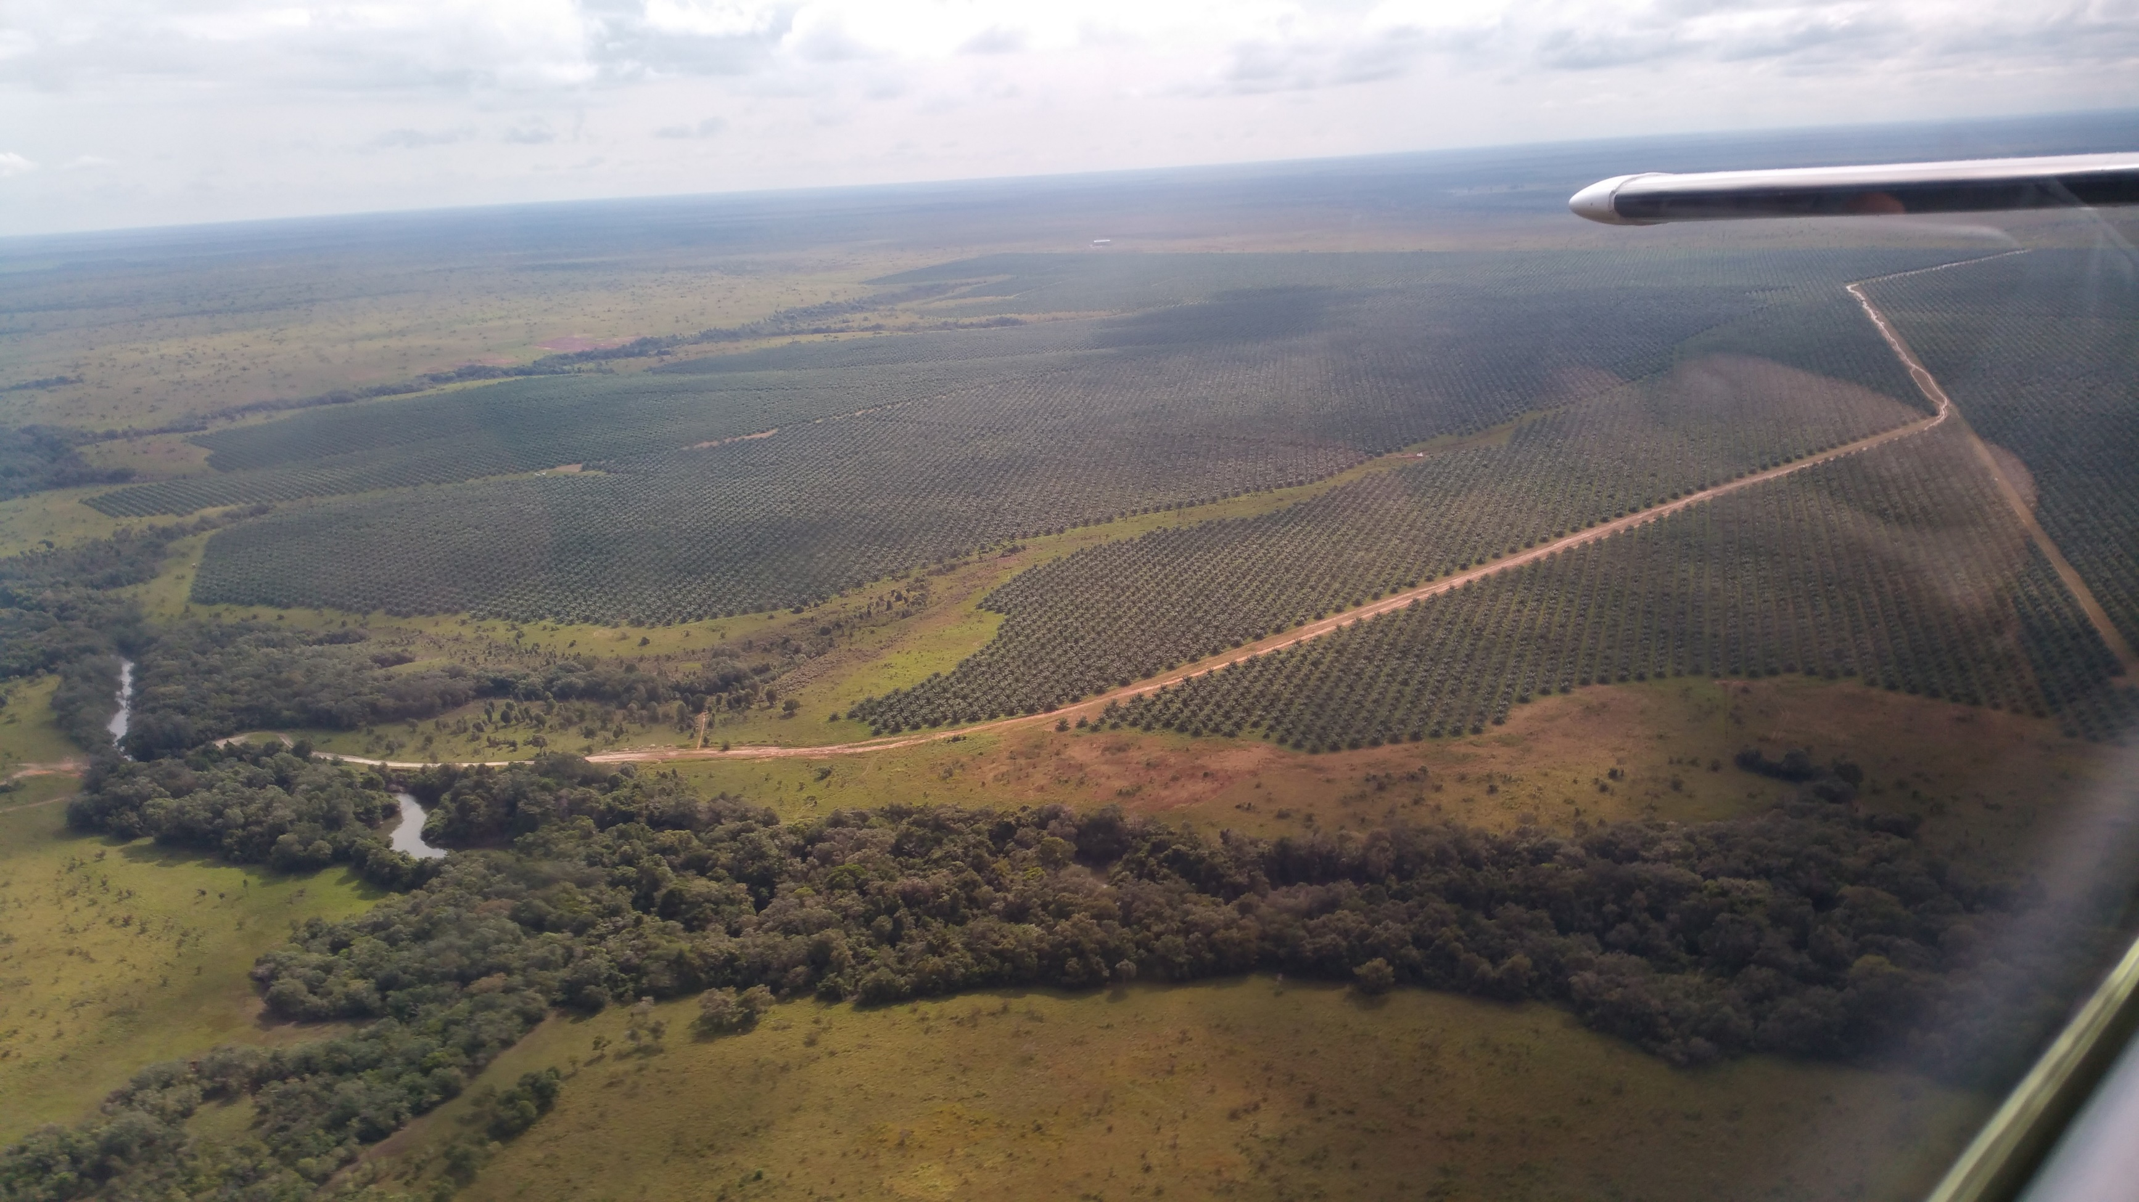
Pilot area of 650 ha
Respecting forests
Substitutes pastures with little biomass, palm captures carbon from the air

Slide 7
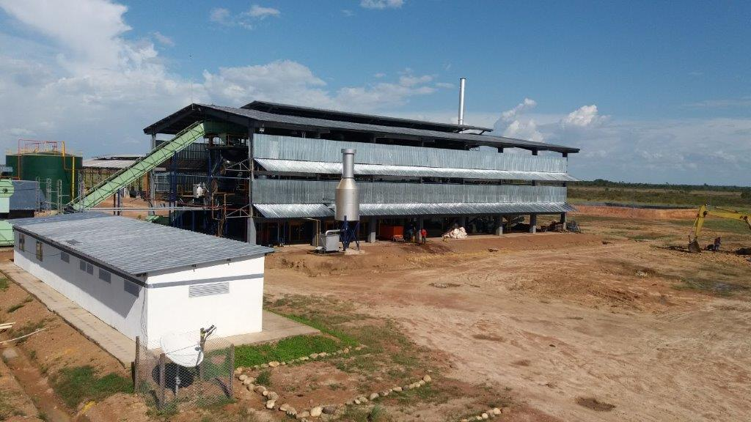
New extractor give less emissions

Slide 8
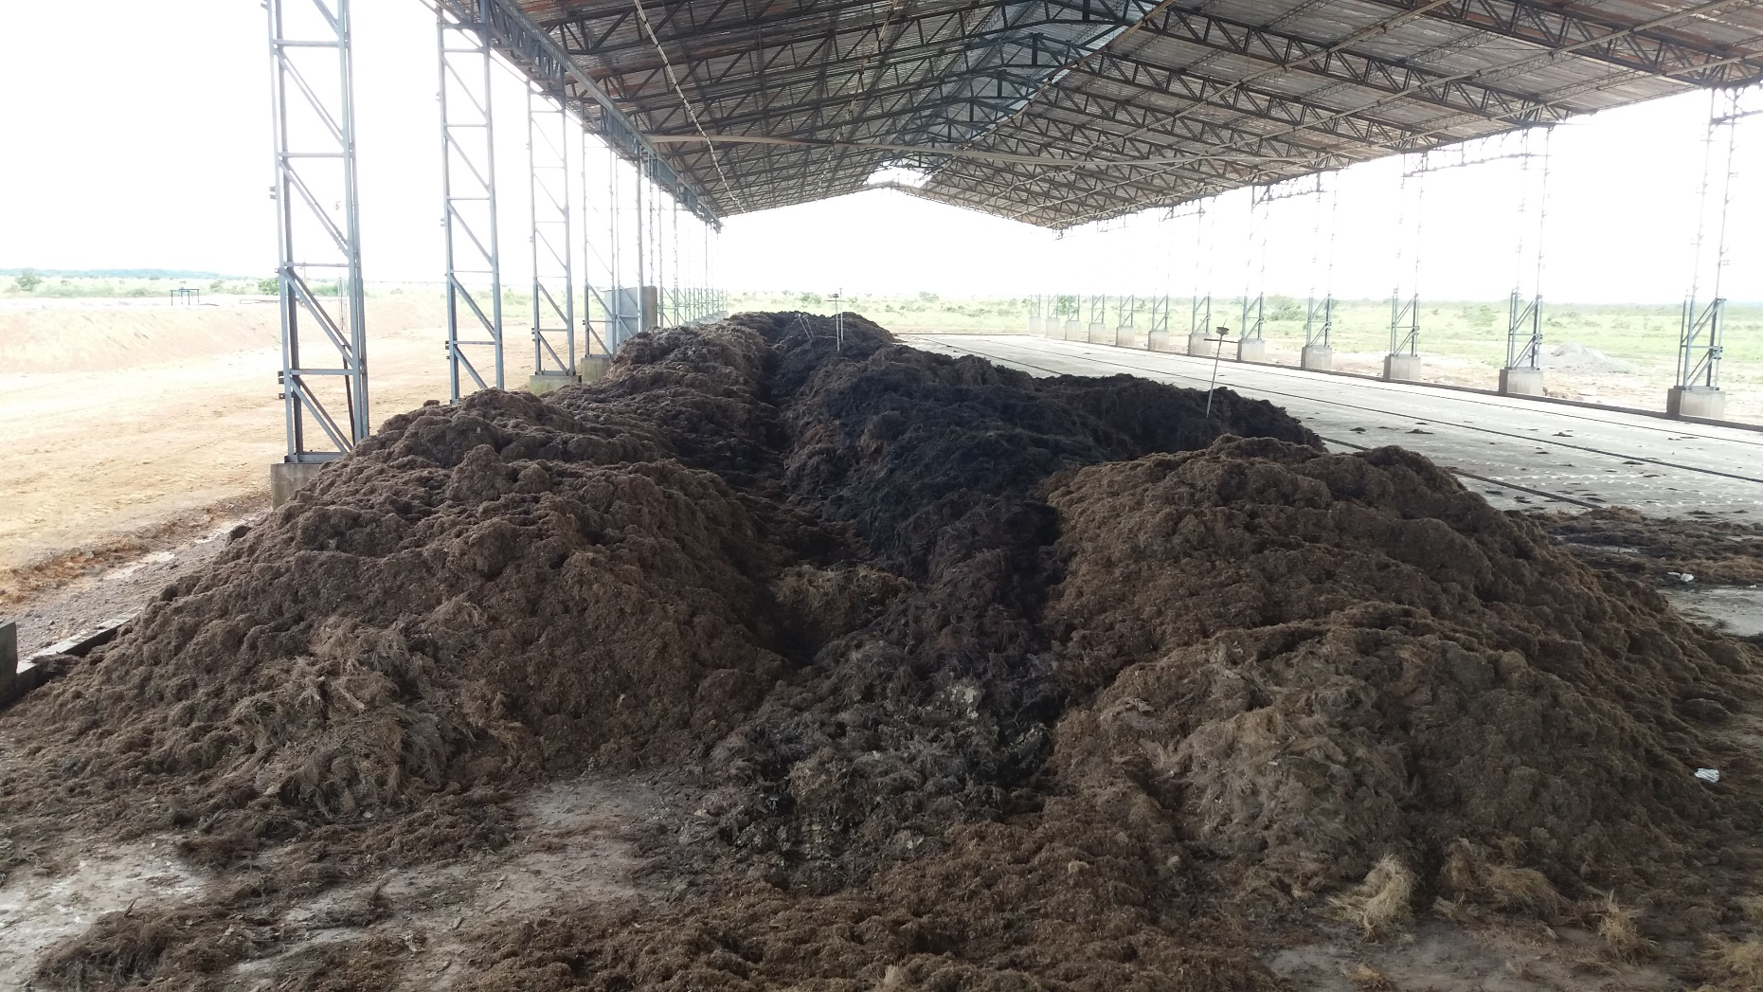
Evaporation plant for effluents and natural composting.
Byproducts of extraction process, biomass and organic effluent, drying with air, no methane, recycling of nutrients reduces need for fertilizers

Slide 9
Altillanura
Environment
No deforestation
Biodiversity
CO₂ capture
-134%
No iLUC
Extensive farming
Peace
Reintegration,
coca producers,
rural displaced
Social
6000 families
“Agro-cluster”
Development

Slide 10
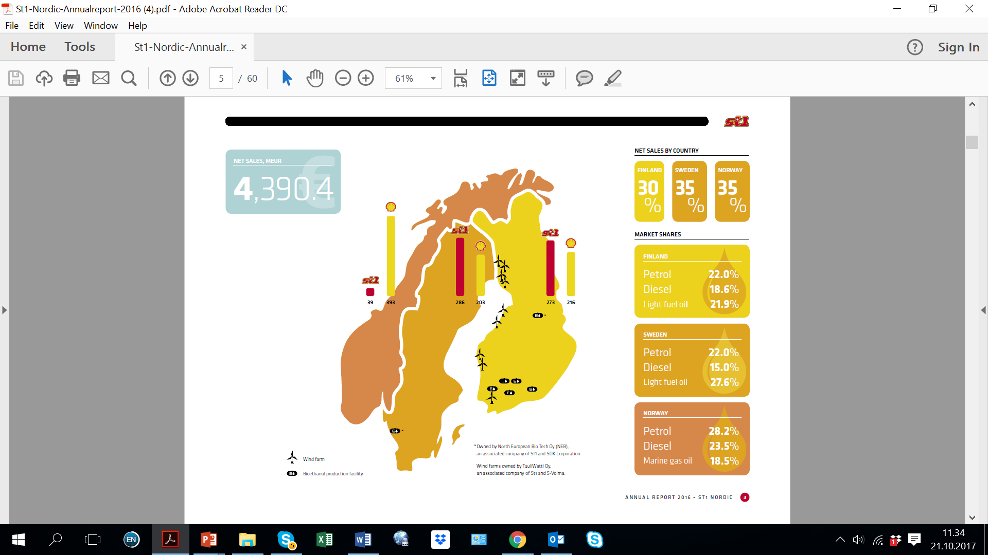

“CO2 aware energy” slogan
Reason will prevail in the long run politics
HVO new refinery 200.000 t/year in Gothenburg
6.5 billion USD total sales

Slide 11
Long term, 250.000 tons/year CPO
ST1- C² Biotrade letter of intention of long-term sales
  Signed 24th November 2017
  St1: Mika Anttonen, Finnish «selfmade billionaire», freedom to act fast
  C²Biotrade, 50% Prestige Colombia SAS and 50% Resgrow AS (Henrik Wiig)
C²Biotrade will sign letter of intent - To produce letter of intention we invite Riopaila!
60.000 ha new plantations
About 770 millon USD investments in Colombia
162 millon USD anual sales of CPO if 650 USD/h
Higher price with mark-up of high level of sustainability
  CPO and certificate is commodity with spot price in Rotterdam
  134% reduction of green house gas emissions deserves a special contract
Share sustainability markup
  Employees, producers, state, C²Biotrade and St1
  Consent industry today pays 15-190 USD/mt more (Daboon, Brazil)
EU Directive of Renewable Energy II in process
  We expect palm as feedstock and minimum 7% conventional biofuel will be accepted

Slide 12
Short term, St1 buy PME and CPO now
St1 willing to buy PME and CPO now to show goodwill
Requires RSPO and ISCC
  C²Biotrade can assist, important to start the process
Preferably product with «carbon capture»
  EU RED accepts 60%, but Altillanura reduces more than 100% of greenhouse gas emissions compared to fossil fuel
  If an extractor does not have methane capture, it can sell CPO now
Can apply mass balance principle trading certificates
  Exchange with product from the coast
C²Biotrade intermediary/representative of St1, control sustainability
Future sales agreement
  Volume, date and delivery site
  Spot price and certification benefit

Slide 13
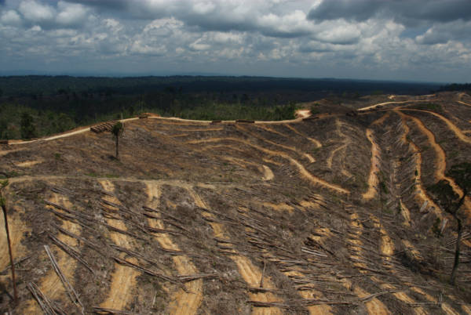
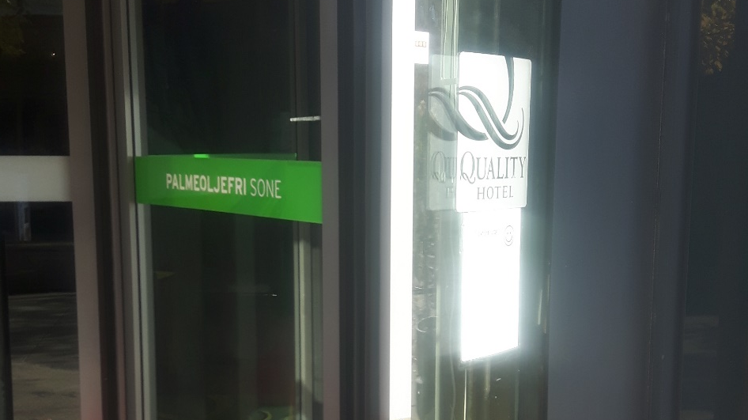


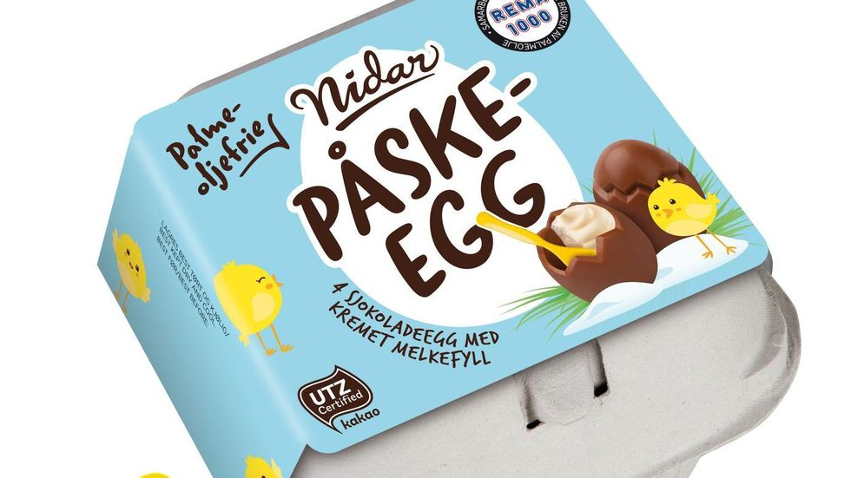
Palm, the good enemy
«Alternative facts» vs. reality
NGO «sustainable palm» does not exist in biodiesel – Food OK
Deforestation – Relieves pressure on the agricultural border of Amazonia.
Prohibited state purchases– Tear down EU, private yes
The same property and biodiesel HVO: Jatropa YES, Palm NO (?!)

Slide 14
Requirements of St1
International Sustainability & Carbon Certification (ISCC)
  Social and environment, RSPO with absolute goals, 60% emissions
Carbon capture
  More than 100% greenhouse gas reduction
New plantations, no existing production
  Net increase of biomass in the world
Maintain food production
  No critical iLUC (indirect land use change)
Plan to reduce indirect effects when the population grows
  Protection of indigenious groups; logging, hunting, ilegal fishing
  Pollution, favelas

Slide 15
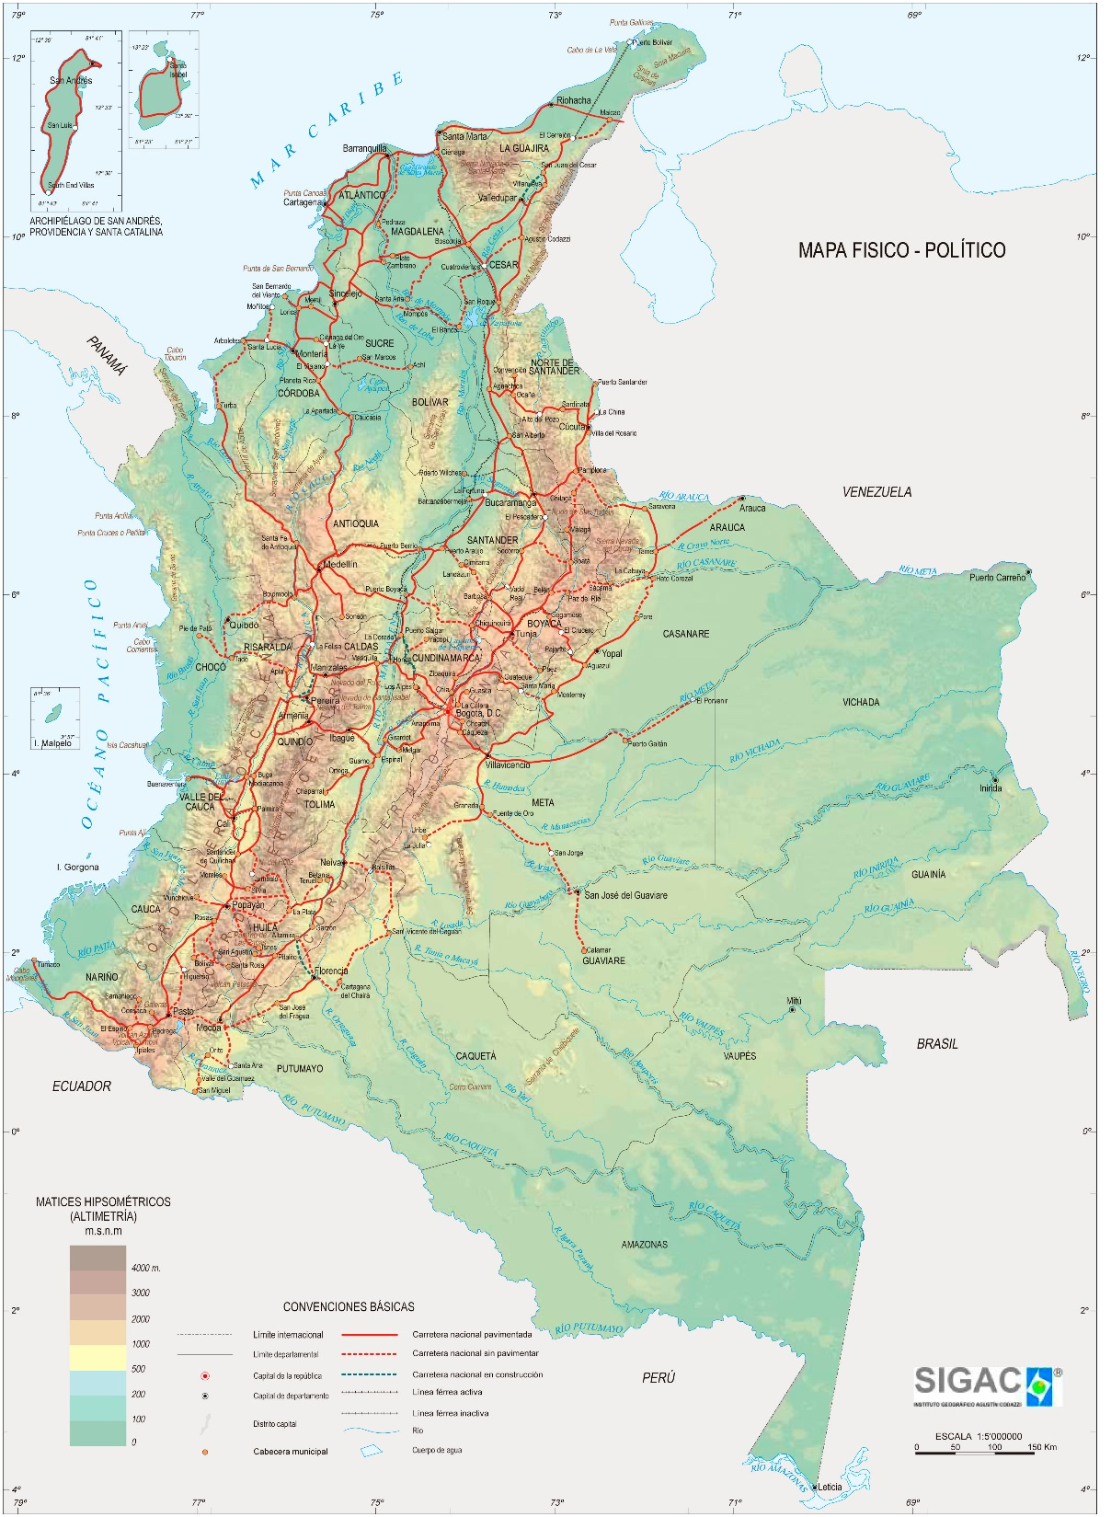
Coordinated project
Prestige 12’ HA Vichada
Neighbours of Altillanura 20’ HA
  Other producers
  Integrated livestock
Other big 5’
Associative production 5’
ZIDRES 20’
IDB/WB if insured sale and institutional support of the state
  Local risk?
  EU regulation risk?
Prestige El Cimarron pilot
Coca substitution / reintegration
Savannah plantations

Slide 16
We need institutional input from the state
Security; Bacrim, mafia, extortion, pirates.
Clearify land tenure;
Permissions needed; production, environmental, road Access, etc.
Planning and regulation of urbanization and land use
Producer security of investing
ST1 avoid bad product publicity

Slide 17
Clarify land tenure
Failed occupation UAF, size and criteria
Large failed occupation, “possession title” by notary
Failed abandoning UAF
Title of property of RR.PP.
Possession, property title in another name (inheritance, purchase-sale)
Forfeiture bona-fide: Restitution of 1991, falsified adjudication of 1994
Defacto globalization of UAFs
State investigation of the history of the property and trial if it can be cultivated, what will happen if there are claims later: Necessary for St1 to defend itself morally against criticism.

Slide 18
Próximo etapas
Inolve WB/IDB in detailed Project planning
  Sustainable Colombia Fund/ Nordic counties can finance?
Letter of intention with producer
  Existing and new, Colombian and international
  Identify land
  Identify incentives, ZIDRES, free zone, ZOMAC, productive projects
List of projects/lands for state clarification
  Branding of land, RR.PP. and ANT
  Restitution, URT
  Planning, DPN
  Transportation, armed force/police, export, etc.
Municipal clarification
A legal and moral government declaration

Slide 19
Opportunity today, tomorrow too late
Competitors of sustanable palm
  Brazil 5 million ha planned, 60 million ha deforested
European lobby subsidises for development of cellulose and algae
Siem Industries, innovators even in Colombia
  Prevous NCL, now petrolium services, navigation, etc.
  Frupor, agricultural export from Portugal for 30 years
St1 needs to fill its new refinery, looks for feedstock somewhere else

Slide 20
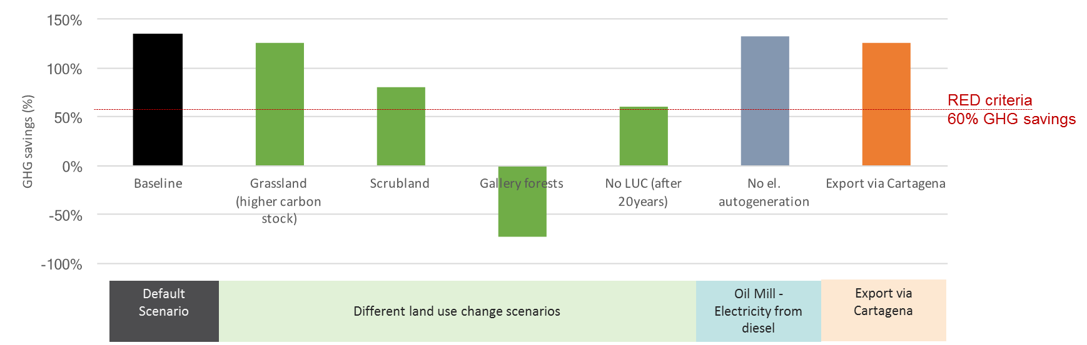
Sensitivity analysis
Calculations by Quantis International for Prestige (Gmünder, 2017)

Slide 21
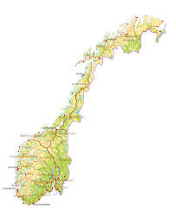
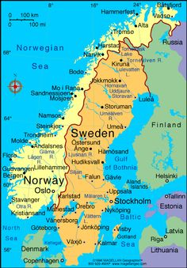
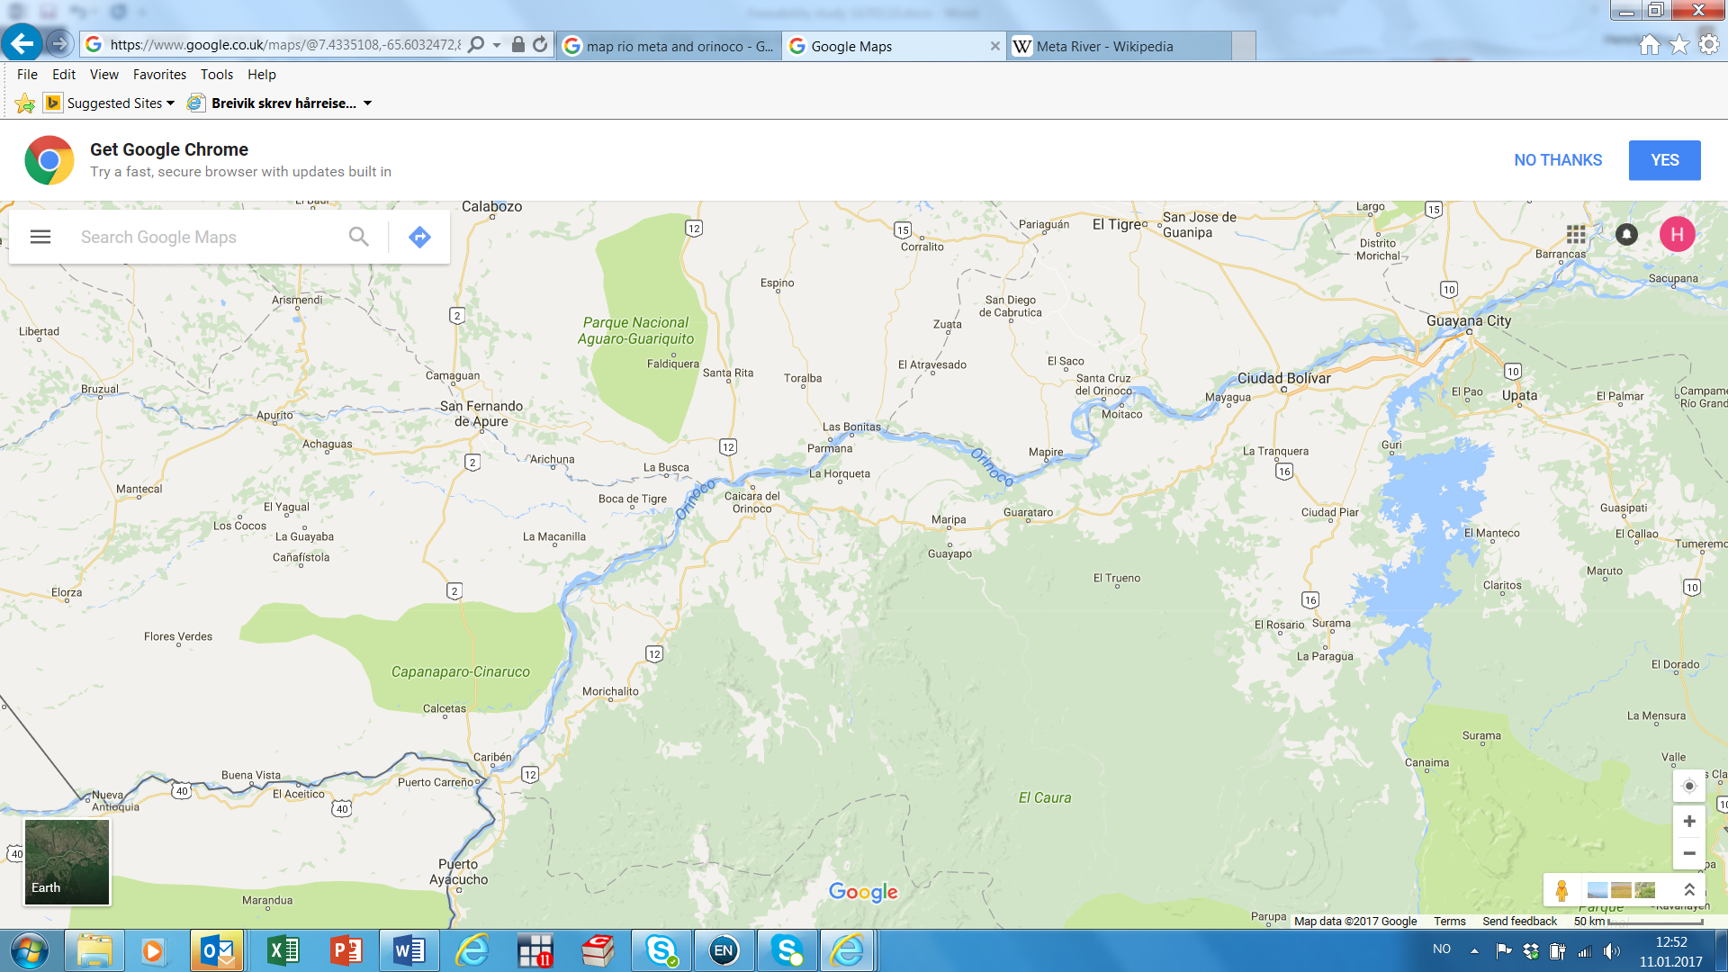
Cerca de Europa cuando Maduro sale…
Tankers to Norway
Meta river and Orinoco river, 36 hours barge to Atlantic port
Oil tankers to Gotenburg
Freight to Puerto Carreño in summer

Slide 22
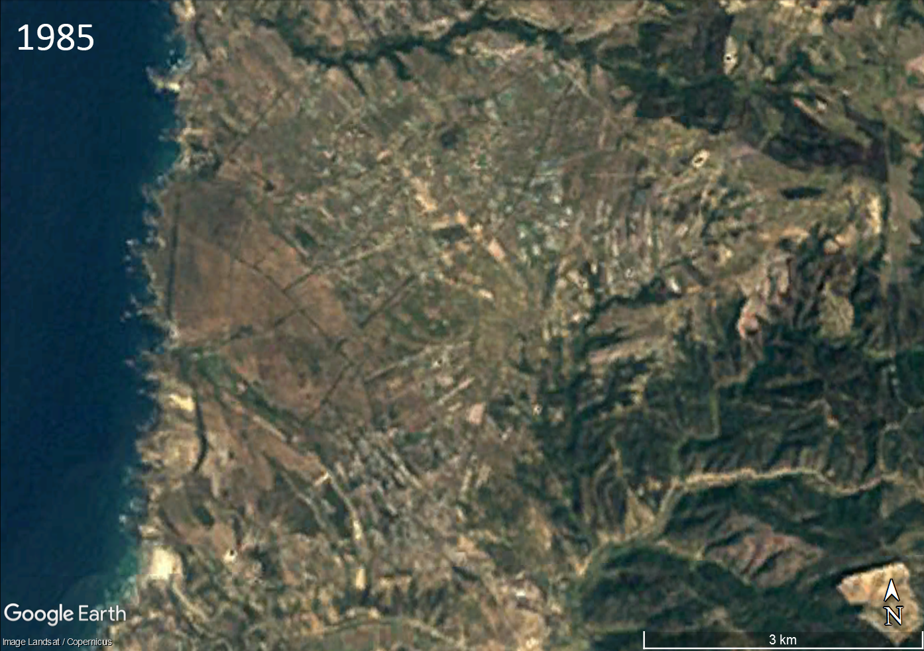

Slide 23
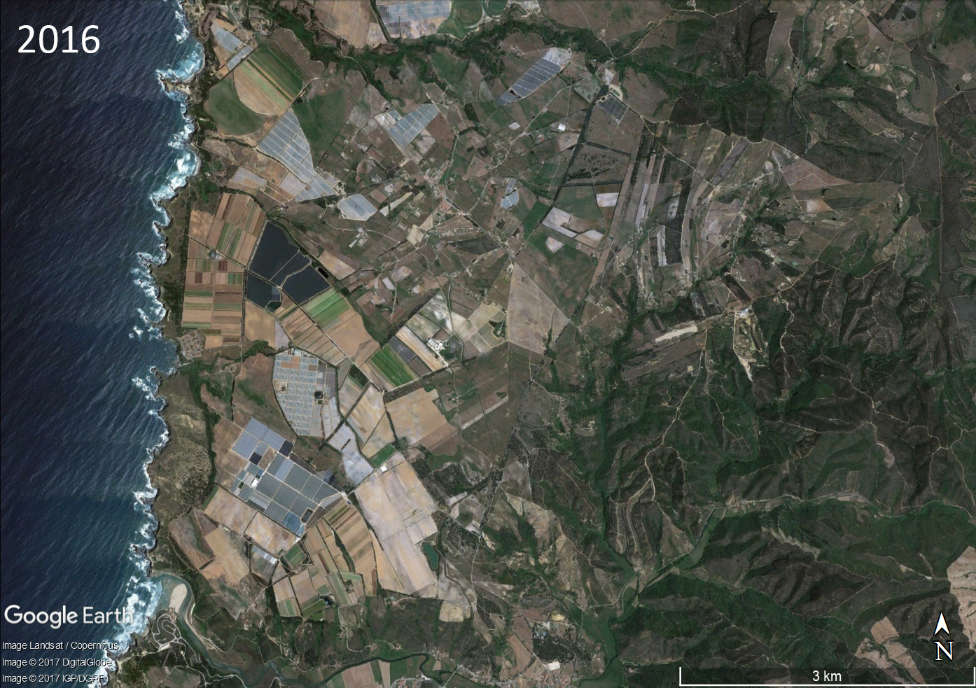

Slide 24
